Slide 1

SILVER OAK COLLEGE OF COMPUTER APPLICATION
SUBJECT :Programming in Python
TOPIC :File Handling, Modules and OOP concepts

Slide 2
Programming with Python
File I/O

Slide 3
File I/O
Files are persistent storage
Allow data to be stored beyond program lifetime
The basic operations on files are
open, close, read, write
Python treat files as sequence of lines
sequence operations work for the data read from files

Slide 4
File I/O: open and close
open(filename, mode)
While opening a file, you need to supply
The name of the file, including the path
The mode in which you want to open a file
Common modes are r (read), w (write), a (append)
Mode is optional, defaults to r
open(..) returns a file object
close() on the file object closes the file
finishes any buffered operations

Slide 5
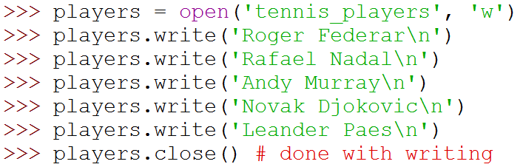
File I/O: Example
Do some writing
How to do it?
see the next few slides

Slide 6
File I/O: read, write and append
Reading from an open file returns the contents of the file
as sequence of lines in the program
Writing to a file
IMPORTANT: If opened with mode 'w', clears the existing contents of the file
Use append mode ('a') to preserve the contents
Writing happens at the end

Slide 7
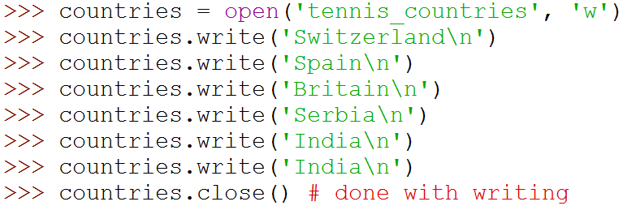
File I/O: Examples

Slide 8
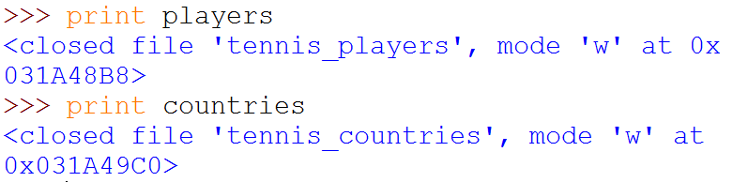
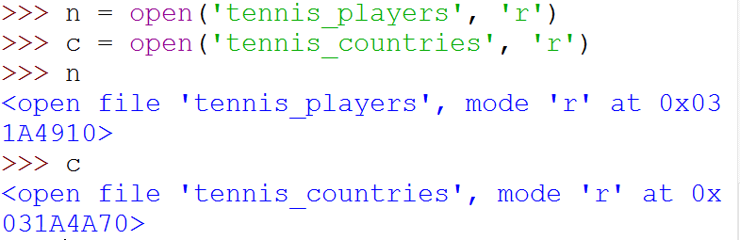
File I/O: Examples
(
)
(
)

Slide 9
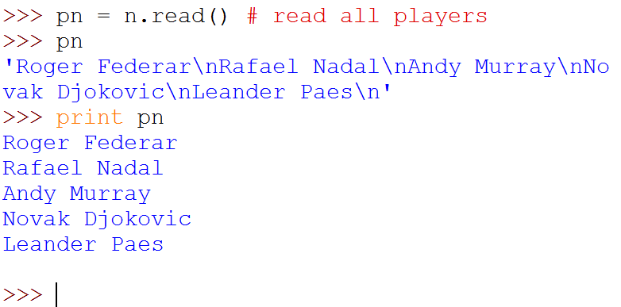

File I/O: Examples
(
)
Note empty line due to '\n'

Slide 10
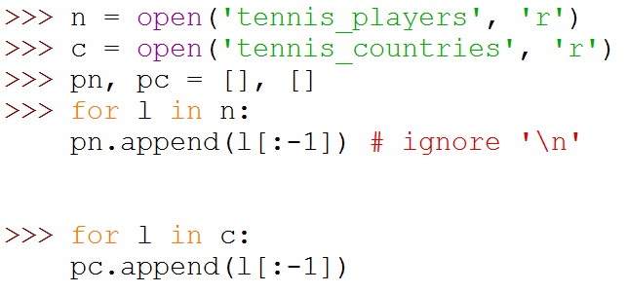

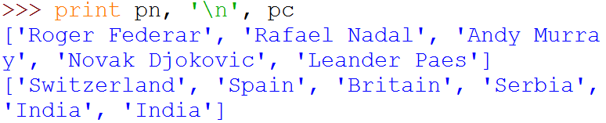
File I/O: Examples
Note the use of for ... in
for sequence
(
)
]

Slide 11
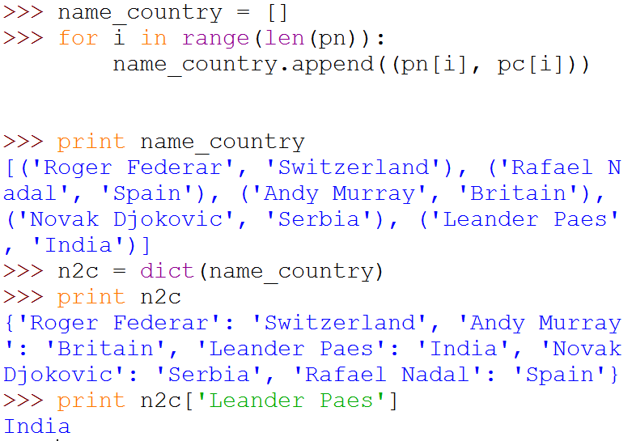
File I/O: Examples
(
)
(
)
(
)

Slide 12
Programming using Python Modules and Packages
Amey Karkare
Dept. of CSE
IIT Kanpur

Slide 13
Modules
As program gets longer, need to organize them for easier access and easier maintenance.
Reuse same functions across programs without copying its definition into each program.
Python allows putting definitions in a file
use them in a script or in an interactive instance of the interpreter
Such a file is called a module
definitions from a module can be imported into other modules or into the main module

Slide 14
Modules
A module is a file containing Python definitions and statements.
The file name is the module name with the suffix .py appended.
Within a module, the module’s name is available in the global variable __name__.

Slide 15
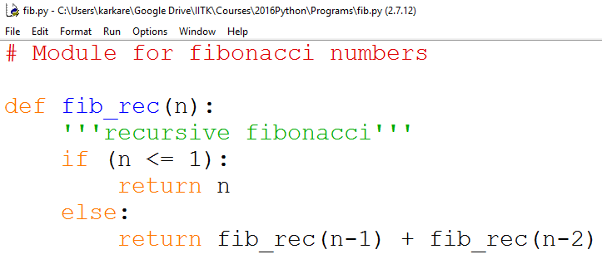
Modules Example
fib.py - C:\

Slide 16
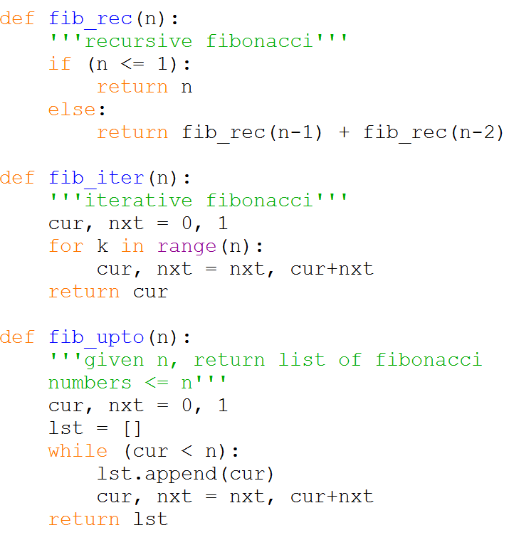
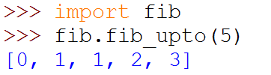
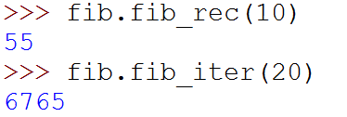

Modules Example
Within a module, the module’s name is available as the value of the global variable __name__.

Slide 17
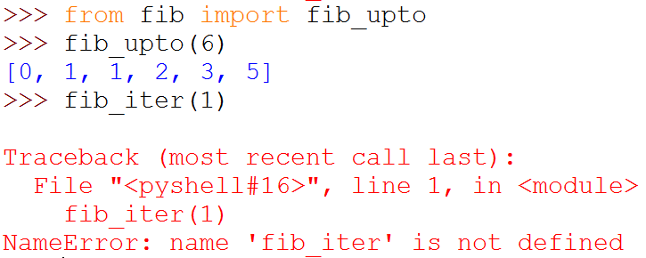
Importing Specific Functions
To import specific functions from a module
This brings only the imported functions in the current symbol table
No need of modulename. (absence of fib. in the example)

Slide 18
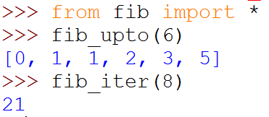
Importing ALL Functions
To import all functions from a module, in the current symbol table
This imports all names except those beginning with an underscore (_).

Slide 19
__main__ in Modules
When you run a module on the command line with
python fib.py <arguments>
the code in the module will be executed, just as if
you imported it, but with the __name__ set to
"__main__".
By adding this code at the end of your module
if __name__ == "__main__":
... # Some code here
you can make the file usable as a script as well as an
importable module

Slide 20
__main__ in Modules
if __name__ == "__main__":
import sys
print (fib_iter(int(sys.argv[1])))
This code parses the command line only if the module is executed as the “main” file:
$ python fib.py 10
55
If the module is imported, the code is not run:
>>> import fib
>>>

Slide 21
Package
A Python package is a collection of Python modules.
Another level of organization.
Packages are a way of structuring Python’s module namespace by using dotted module names.
The module name A.B designates a submodule named B in a package named A.
The use of dotted module names saves the authors of multi-module packages like NumPy or Pillow from having to worry about each other’s module names.

Slide 22
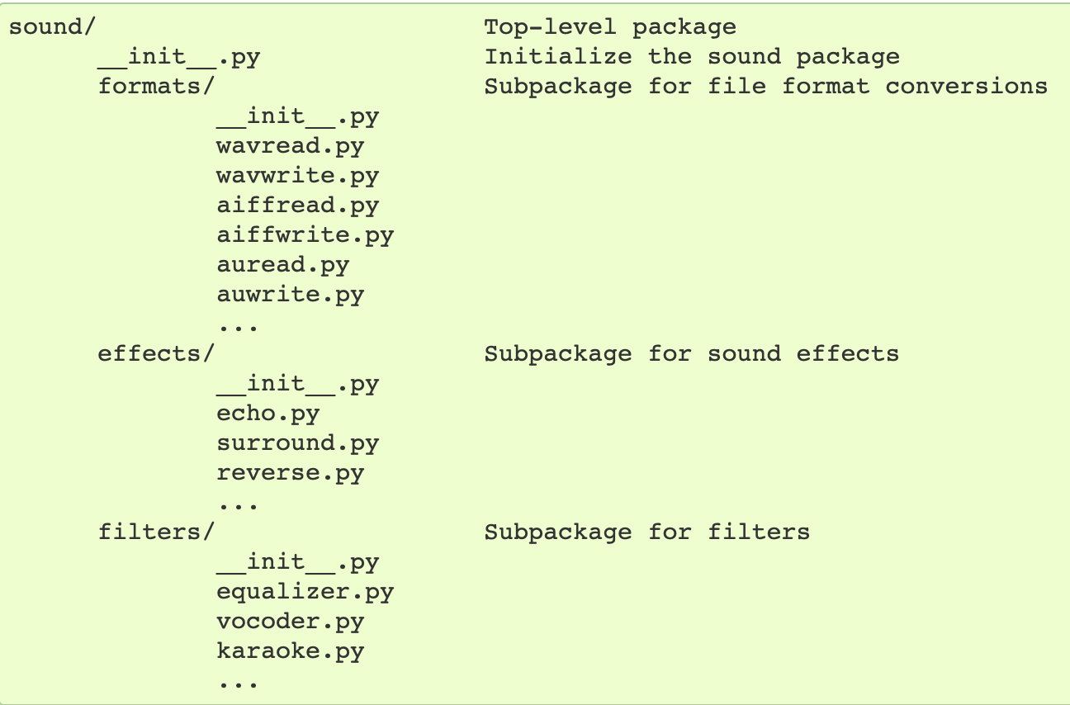
A sound Package
https://docs.python.org/3/tutorial/modules.html

Slide 23
A sound Package
What are these files with funny names?
https://docs.python.org/3/tutorial/modules.html

Slide 24
__init.py__
The __init__.py files are required to make Python treat directories containing the file as packages.
This prevents directories with a common name, such as string, unintentionally hiding valid modules that occur later on the module search path.
__init__.py can just be an empty file
It can also execute initialization code for the package

Slide 25
Importing Modules from Packages
https://docs.python.org/3/tutorial/modules.html

Slide 26
Importing Modules from Packages
import sound.effects.echo
Loads the submodule sound.effects.echo
It must be referenced with its full name:
sound.effects.echo.echofilter(
input, output,
delay=0.7, atten=4
)

Slide 27
Importing Modules from Packages
from sound.effects import echo
This also loads the submodule echo
Makes it available without package prefix
It can be used as:
echo.echofilter(
input, output,
delay=0.7, atten=4
)

Slide 28
Importing Modules from Packages
from sound.effects.echo import echofilter
This loads the submodule echo, but this makes its function echofilter() directly available.
echofilter(input, output,
delay=0.7, atten=4)

Slide 29
Popular Packages
pandas, numpy, scipy, matplotlib, …
Provide a lot of useful functions
Notes:
https://pandas.pydata.org/pandas-docs/stable/getting_started/tutorials.html

Slide 30
Object Oriented Programming in Python: Defining Classes

Slide 31
It’s all objects…
Everything in Python is really an object.
We’ve seen hints of this already… “hello”.upper() list3.append(‘a’) dict2.keys()
These look like Java or C++ method calls.
New object classes can easily be defined in addition to these built-in data-types.
In fact, programming in Python is typically done in an object oriented fashion.

Slide 32
Defining a Class
A class is a special data type which defines how to build a certain kind of object.
The class also stores some data items that are shared by all the instances of this class
Instances are objects that are created which follow the definition given inside of the class
Python doesn’t use separate class interface definitions as in some languages
You just define the class and then use it

Slide 33
Methods in Classes
Define a method in a class by including function definitions within the scope of the class block
There must be a special first argument self in all of method definitions which gets bound to the calling instance
There is usually a special method called __init__ in most classes
We’ll talk about both later…

Slide 34
A simple class def: student
class student: “““A class representing a student ””” def __init__(self,n,a): self.full_name = n self.age = a def get_age(self): return self.age

Slide 35
Creating and Deleting Instances

Slide 36
Instantiating Objects
There is no “new” keyword as in Java.
Just use the class name with ( ) notation and assign the result to a variable
__init__ serves as a constructor for the class. Usually does some initialization work
The arguments passed to the class name are given to its __init__() method
So, the __init__ method for student is passed “Bob” and 21 and the new class instance is bound to b:
b = student(“Bob”, 21)

Slide 37
Constructor: __init__
An __init__ method can take any number of arguments.
Like other functions or methods, the arguments can be defined with default values, making them optional to the caller.
However, the first argument self in the definition of __init__ is special…

Slide 38
Self
The first argument of every method is a reference to the current instance of the class
By convention, we name this argument self
In __init__, self refers to the object currently being created; so, in other class methods, it refers to the instance whose method was called
Similar to the keyword this in Java or C++
But Python uses self more often than Java uses this

Slide 39
Self
Although you must specify self explicitly when defining the method, you don’t include it when calling the method.
Python passes it for you automatically
Defining a method: Calling a method:
(this code inside a class definition.)
def set_age(self, num): >>> x.set_age(23) self.age = num

Slide 40
Deleting instances: No Need to “free”
When you are done with an object, you don’t have to delete or free it explicitly.
Python has automatic garbage collection.
Python will automatically detect when all of the references to a piece of memory have gone out of scope. Automatically frees that memory.
Generally works well, few memory leaks
There’s also no “destructor” method for classes

Slide 41
Access to Attributes and Methods

Slide 42
Definition of student
class student: “““A class representing a student ””” def __init__(self,n,a): self.full_name = n self.age = a def get_age(self): return self.age

Slide 43
Traditional Syntax for Access
>>> f = student(“Bob Smith”, 23)
>>> f.full_name # Access attribute
“Bob Smith”
>>> f.get_age() # Access a method
23

Slide 44
Accessing unknown members
Problem: Occasionally the name of an attribute or method of a class is only given at run time…
Solution:
getattr(object_instance, string)
string is a string which contains the name of an attribute or method of a class
getattr(object_instance, string) returns a reference to that attribute or method

Slide 45
getattr(object_instance, string)
>>> f = student(“Bob Smith”, 23)
>>> getattr(f, “full_name”)
“Bob Smith”
>>> getattr(f, “get_age”)
<method get_age of class studentClass at 010B3C2>
>>> getattr(f, “get_age”)() # call it
23
>>> getattr(f, “get_birthday”)
# Raises AttributeError – No method!

Slide 46
hasattr(object_instance,string)
>>> f = student(“Bob Smith”, 23)
>>> hasattr(f, “full_name”)
True
>>> hasattr(f, “get_age”)
True
>>> hasattr(f, “get_birthday”)
False

Slide 47
Attributes

Slide 48
Two Kinds of Attributes
The non-method data stored by objects are called attributes
Data attributes
Variable owned by a particular instance of a class
Each instance has its own value for it
These are the most common kind of attribute
Class attributes
Owned by the class as a whole
All class instances share the same value for it
Called “static” variables in some languages
Good for (1) class-wide constants and (2) building counter of how many instances of the class have been made

Slide 49
Data Attributes
Data attributes are created and initialized by an __init__() method.
Simply assigning to a name creates the attribute
Inside the class, refer to data attributes using self
for example, self.full_name
class teacher: “A class representing teachers.” def __init__(self,n): self.full_name = n def print_name(self): print self.full_name

Slide 50
Class Attributes
Because all instances of a class share one copy of a class attribute, when any instance changes it, the value is changed for all instances
Class attributes are defined within a class definition and outside of any method
Since there is one of these attributes per class and not one per instance, they’re accessed via a different notation:
Access class attributes using self.__class__.name notation -- This is just one way to do this & the safest in general.
class sample: >>> a = sample() x = 23 >>> a.increment() def increment(self): >>> a.__class__.x self.__class__.x += 1 24

Slide 51
Data vs. Class Attributes
class counter: overall_total = 0 # class attribute def __init__(self): self.my_total = 0 # data attribute def increment(self): counter.overall_total = \ counter.overall_total + 1 self.my_total = \ self.my_total + 1
>>> a = counter() >>> b = counter() >>> a.increment() >>> b.increment() >>> b.increment() >>> a.my_total 1 >>> a.__class__.overall_total 3 >>> b.my_total 2 >>> b.__class__.overall_total 3

Slide 52
Inheritance

Slide 53
Subclasses
A class can extend the definition of another class
Allows use (or extension ) of methods and attributes already defined in the previous one.
New class: subclass. Original: parent, ancestor or superclass
To define a subclass, put the name of the superclass in parentheses after the subclass’s name on the first line of the definition. Class Cs_student(student):
Python has no ‘extends’ keyword like Java.
Multiple inheritance is supported.

Slide 54
Redefining Methods
To redefine a method of the parent class, include a new definition using the same name in the subclass.
The old code won’t get executed.
To execute the method in the parent class in addition to new code for some method, explicitly call the parent’s version of the method.
parentClass.methodName(self, a, b, c)
The only time you ever explicitly pass ‘self’ as an argument is when calling a method of an ancestor.

Slide 55
Definition of a class extending student
Class Student: “A class representing a student.”
def __init__(self,n,a): self.full_name = n self.age = a
def get_age(self): return self.age
Class Cs_student (student): “A class extending student.” def __init__(self,n,a,s): student.__init__(self,n,a) #Call __init__ for student
self.section_num = s def get_age(): #Redefines get_age method entirely print “Age: ” + str(self.age)

Slide 56
Extending __init__
Same as for redefining any other method…
Commonly, the ancestor’s __init__ method is executed in addition to new commands.
You’ll often see something like this in the __init__ method of subclasses:
parentClass.__init__(self, x, y) where parentClass is the name of the parent’s class.

Slide 57
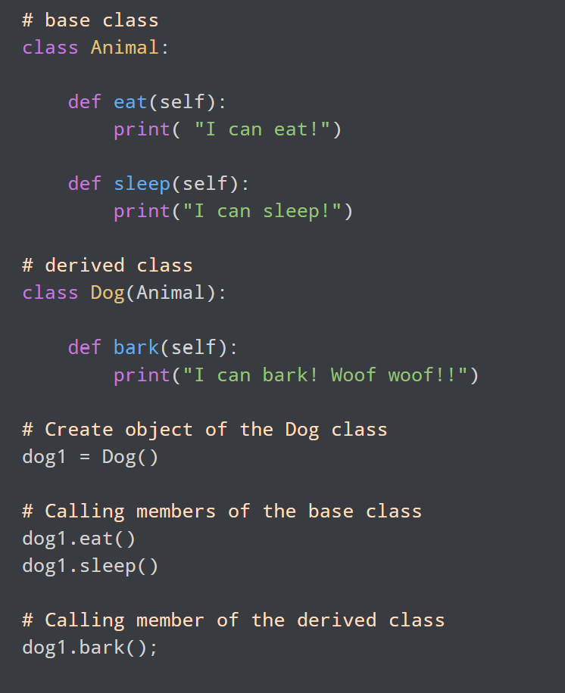
Inheritance Example
Here, dog1 (the object of derived class Dog) can access members of the base class Animal. It's because Dog is inherited from Animal.
Output:
I can eat!
I can sleep!
I can bark! Woof woof!!

Slide 58
Encapsulation
Encapsulation is one of the key features of object-oriented programming. Encapsulation refers to the bundling of attributes and methods inside a single class.
It prevents outer classes from accessing and changing attributes and methods of a class. This also helps to achieve data hiding.

Slide 59
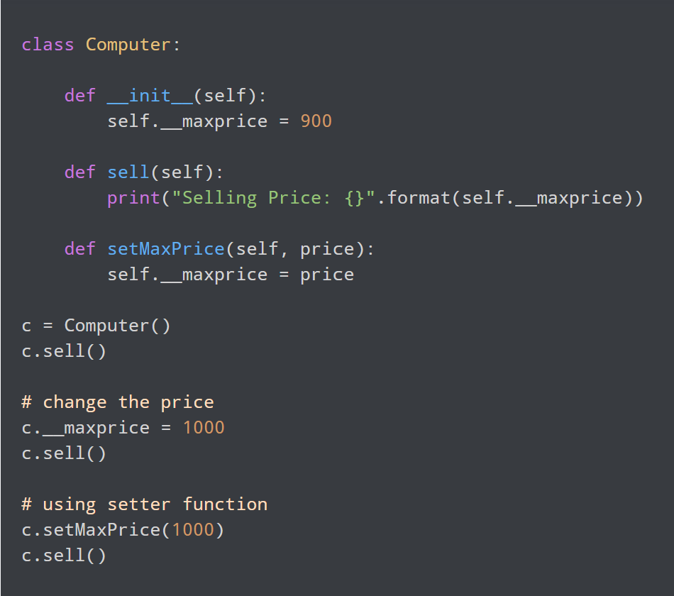
Example
In the above program, we defined a Computer class.
We used __init__() method to store the maximum selling price of Computer. Here, notice the code
c.__maxprice = 1000
Here, we have tried to modify the value of __maxprice outside of the class. However, since __maxprice is a private variable, this modification is not seen on the output.
As shown, to change the value, we have to use a setter function i.e setMaxPrice() which takes price as a parameter.
Output:: Selling Price: 900
Selling Price: 900
Selling Price: 1000

Slide 60
Polymorphism
Polymorphism is another important concept of object-oriented programming. It simply means more than one form.
That is, the same entity (method or operator or object) can perform different operations in different scenarios.

Slide 61
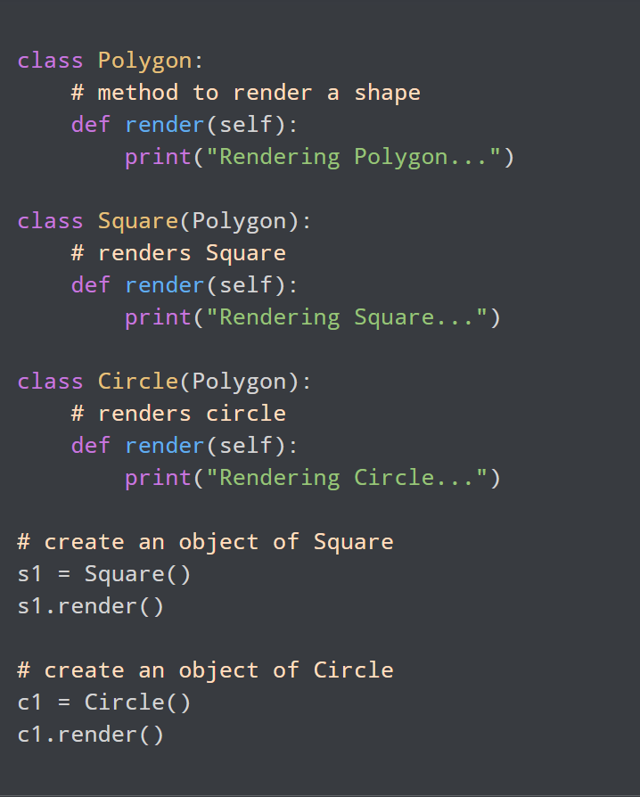
Example
In the above example, we have created a superclass: Polygon and two subclasses: Square and Circle. Notice the use of the render() method.
The main purpose of the render() method is to render the shape. However, the process of rendering a square is different from the process of rendering a circle.
Hence, the render() method behaves differently in different classes. Or, we can say render() is polymorphic.
Output:
Rendering Square...
Rendering Circle...

Slide 62
Data Abstraction in Python
Data abstraction in Python is a programming concept that hides complex implementation details while exposing only essential information and functionalities to users. In Python, we can achieve data abstraction by using abstract classes and abstract classes can be created using abc (abstract base class) module and abstractmethod of abc module.
Abstraction classes in Python
Abstract class is a class in which one or more abstract methods are defined. When a method is declared inside the class without its implementation is known as abstract method.
Abstract Method: In Python, abstract method feature is not a default feature as in Java. To create abstract method and abstract classes we have to import the “ABC” and “abstractmethod” classes from abc (Abstract Base Class) library. Abstract method of base class force its child class to write the implementation of the all abstract methods defined in base class. If we do not implement the abstract methods of base class in the child class then our code will give error. In the below code method_1 is a abstract method created using @abstractmethod decorator.

Slide 63
Example
Steps to Create Abstract Base Class and Abstract Method:
Firstly, we import ABC and abstractmethod class from abc (Abstract Base Class) library.
Create a BaseClass that inherits from the ABC class. In Python, when a class inherits from ABC, it indicates that the class is intended to be an abstract base class.
Inside BaseClass we declare an abstract method named “method_1” by using “abstractmethod” decorater. Any subclass derived from BaseClass must implement this method_1 method. We write pass in this method which indicates that there is no code or logic in this method.
from abc import ABC, abstractmethod
class BaseClass(ABC):
@abstractmethod
def method_1(self):
#empty body
pass

Slide 64
Iterators
An iterator is an object which contains a countable number of values and it is used to iterate over iterable objects like list, tuples, sets, etc. Iterators are implemented using a class and a local variable for iterating is not required here, It follows lazy evaluation where the evaluation of the expression will be on hold and stored in the memory until the item is called specifically which helps us to avoid repeated evaluation. As lazy evaluation is implemented, it requires only 1 memory location to process the value and when we are using a large dataset then, wastage of RAM space will be reduced the need to load the entire dataset at the same time will not be there.
Using an iterator-
iter() keyword is used to create an iterator containing an iterable object.
next() keyword is used to call the next element in the iterable object.
After the iterable object is completed, to use them again reassign them to the same object.

Slide 65
Generators
It is another way of creating iterators in a simple way where it uses the keyword “yield” instead of returning it in a defined function. Generators are implemented using a function. Just as iterators, generators also follow lazy evaluation. Here, the yield function returns the data without affecting or exiting the function. It will return a sequence of data in an iterable format where we need to iterate over the sequence to use the data as they won’t store the entire sequence in the memory.

Slide 66
Iterator vs Generator
Iterator | Generator
Class is used to implement an iterator | Function is used to implement a generator.
Local Variables aren’t used here. | All the local variables before the yield function are stored.
Iterators are used mostly to iterate or convert other objects to an iterator using iter() function. | Generators are mostly used in loops to generate an iterator by returning all the values in the loop without affecting the iteration of the loop
Iterator uses iter() and next() functions | Generator uses yield keyword
Every iterator is not a generator | Every generator is an iterator

Slide 67
Examples
Iteration example:
iter_list = iter(['Geeks', 'For', 'Geeks'])
print(next(iter_list))
print(next(iter_list))
print(next(iter_list))
Generator Example:
def sq_numbers(n):
for i in range(1, n+1):
yield i*i
a = sq_numbers(3)
print("The square of numbers 1,2,3 are : ")
print(next(a))
print(next(a))
print(next(a))

